Slide 1
Ensemble Methods: Business Use Cases
By Stefan Huber | DATA607
Improving Prediction Accuracy Through Model Combination.

Slide 2

Overview of Ensemble Methods
Ensemble methods combine multiple models to enhance prediction accuracy.
Business Use Cases:
Retail Demand Forecasting: Improve sales predictions by combining seasonal, trend, and promotional models.
Fraud Detection: Identify fraudulent transactions in real time by aggregating multiple detection algorithms.
Further Learning:
Ensemble Techniques (Machine Learning Mastery)
Ensemble Methods (Analytics Vidhya)

Slide 3
01
Bagging

Slide 4

Bagging (Bootstrap Aggregating)
Uses bootstrap samples to build multiple models and averages the predictions to reduce variance.
Business Use Cases:
Credit Risk Modeling: Enhance stability in default predictions across diverse borrower profiles.
Customer Churn Prediction: Smooth out the noise in customer behavior data for more reliable retention strategies.
Further Learning:
Bagging in R (R-bloggers)
Develop a Bagging Ensemble with Different Data Transformations (Machine Learning Mastery)

Slide 5
02
Random Forests

Slide 6

Random Forests
Extension of bagging that adds randomness by selecting a subset of predictors at each split.
Business Use Cases:
Healthcare Diagnostics: Combining multiple biomarkers and patient data for more accurate disease prediction.
Marketing Segmentation: Identifying complex customer segments by capturing non-linear relationships in behavioral data.
Further Learning:
Random Forest Algorithm (StatQuest YouTube)
Advanced Random Forest Techniques (R-bloggers)

Slide 7
03
Boosting

Slide 8

Boosting
Sequential model fitting that focuses on improving predictions for observations with large errors.
Business Use Cases:
Insurance Claim Prediction: Identifying high-risk policies by iteratively improving prediction accuracy.
Real Estate Valuation: Capturing complex property value determinants through sequential model refinement.
Further Learning:
XGBoost with R (Analytics Vidhya)
Gradient Boosting Regressor, Explained (Towards Data Science)

Slide 9
04
Cubist

Slide 10
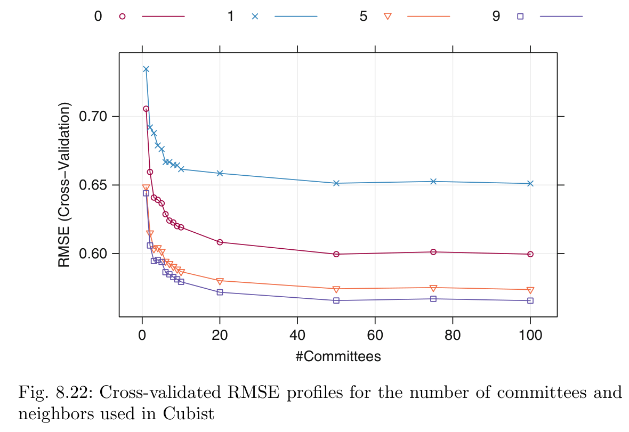
Cubist Model
Rule-based model that combines model trees with instance-based adjustments.
Business Use Cases:
Environmental Monitoring: Predicting pollution levels by combining rule-based models with local adjustments.
Financial Analysis: Understanding nuanced relationships in economic indicators for investment decision-making.

Slide 11
05
Computing

Slide 12

Computing Tools & Packages
There are many R packages useful for ensemble methods and their integration.
Business Use Cases:
Cross-Industry Applications: Rapid prototyping and deployment across various sectors using standardized workflows.
Efficient Model Tuning: Streamlined parameter optimization using packages like caret for consistent evaluation.
Further Learning:
Caret Package Documentation and Tutorials (CRAN)
Learn R Programming (Swirl)

Slide 13
Q&A

